Slide 1
STEGANOGRAPHY
CAPSTONE PROJECT
Presented By: MD ARBAZ
Student Name : MD ARBAZ
College Name & Department : NAWAB SHAHA ALAM KHAN COLLEGE OF ENGINEERING & TECHNOLOGY

Slide 2
OUTLINE
Problem Statement
Technology used
Wow factor
End users
Result
Conclusion
Git-hub Link
Future scope

Slide 3
Problem Statement
The goal of this project is to develop an image-based encryption and decryption system. The system allows users to encode a secret message into an image using a password for security. It utilizes pixel manipulation in an image to hide the message. The encrypted image can only be decrypted by providing the correct password. This approach combines basic cryptography and steganography principles. It offers a simple solution for hiding text messages within images. The technique is implemented in Python using OpenCV, which is widely used for image processing tasks. The project aims to help users understand encryption and steganography in a practical context.

Slide 4
Technology used
Python: The programming language chosen for this project due to its simplicity and the availability of libraries.
OpenCV (CV2): A popular library used for computer vision tasks, here utilized for image manipulation and pixel access.
OS module: Used to open the encrypted image after the encryption process, ensuring smooth integration with the operating system.
Basic Cryptography: A basic encryption technique, encoding each character of the message into pixel values.
Input/Output Operations: User input is taken for the message and password, and the output is an encrypted image.
Steganography: The technique of hiding a message in plain sight, in this case, within the image.
Python Dictionaries: Used to map characters to pixel values and vice versa, aiding in the encryption/decryption process.

Slide 5
Wow factors
Steganography: The ability to hide a message within an image is a fascinating concept that adds an element of secrecy.
Password Protection: The message is protected by a password, ensuring that only authorized users can decrypt the message.
Simple Encryption: The use of pixel values as a medium for encryption provides a novel approach to data security.
Practical Application: The project can be used to hide sensitive information in a way that is not immediately obvious to others.
User-friendly: With a simple interface and easy-to-follow inputs, the system is accessible to even novice users.
Educational Value: The project is a great learning tool for understanding the basics of cryptography and steganography.
Versatility: The approach can be adapted to other media types, such as audio or video, for advanced steganography applications.

Slide 6
End users
Private Users: Ideal for individuals who want to send confidential messages that are hidden within an image.
Developers: Can use this code as a base for building more secure encryption systems or learning about cryptography.
Cybersecurity Enthusiasts: Great for people looking to learn more about the applications of steganography and encryption in securing messages.
Educational Institutions: Useful for teaching cryptography and digital security in computer science and engineering courses.
Hackers: Those interested in exploring steganography for ethical hacking or security testing purposes.
Content Creators: Individuals who want to protect their messages or files before sharing them publicly.
Researchers: Can utilize the technique as a starting point for exploring more advanced cryptographic methods.

Slide 7
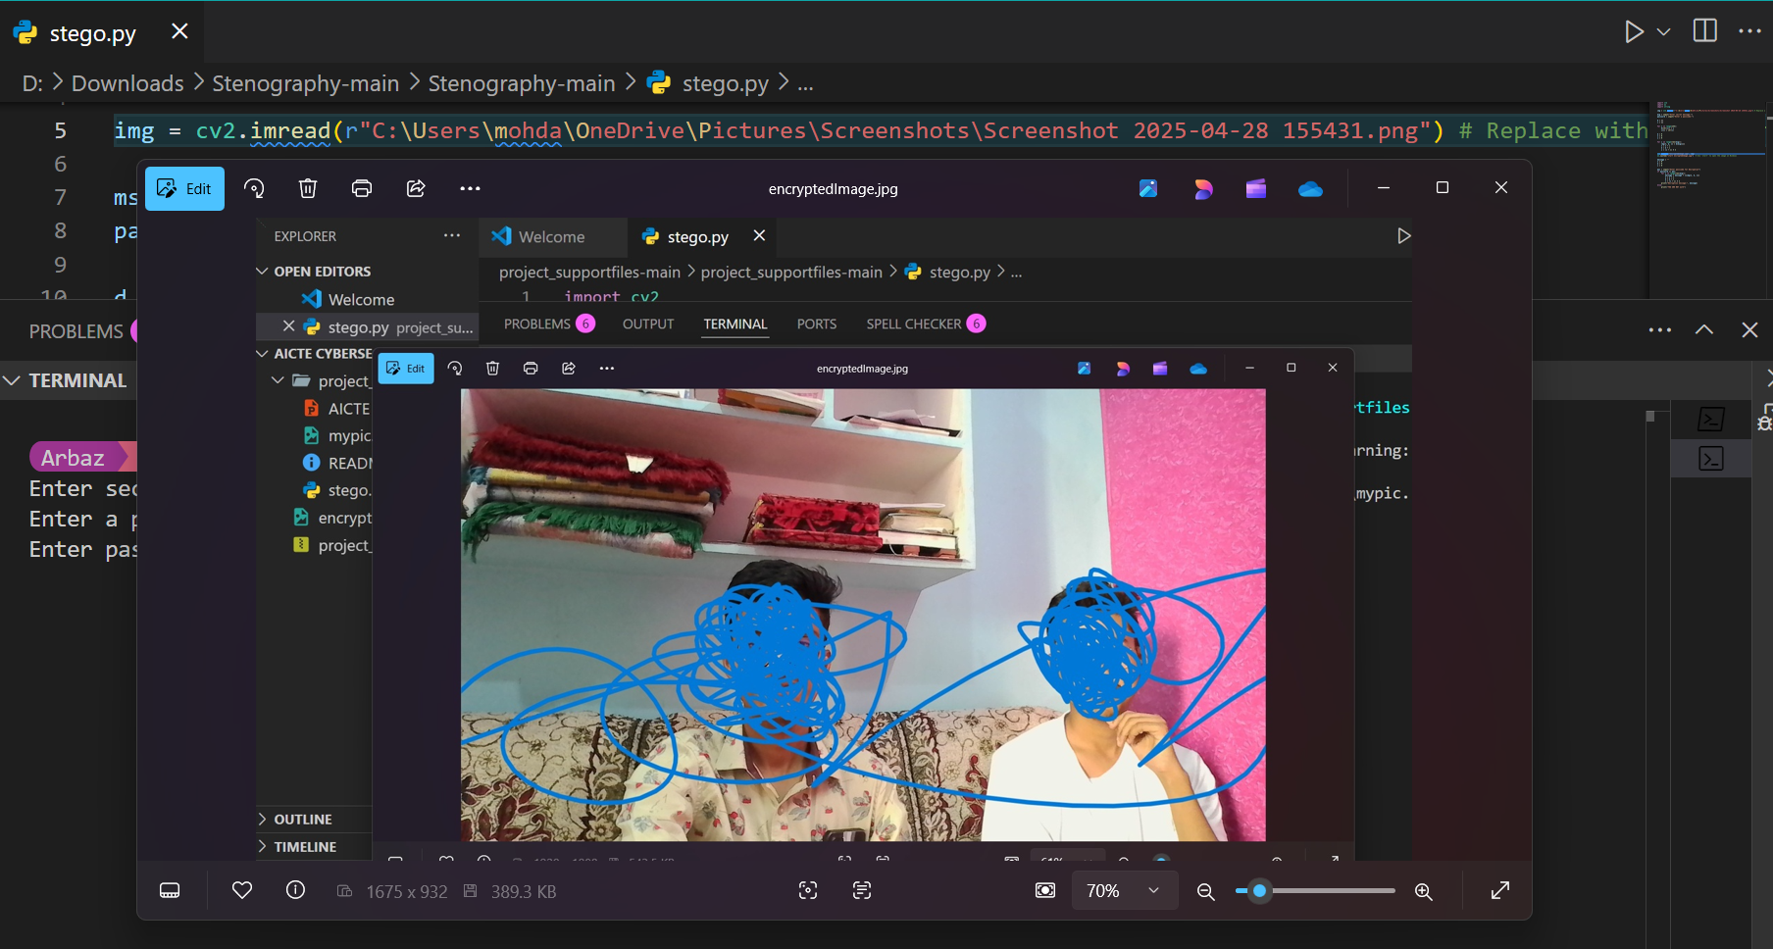
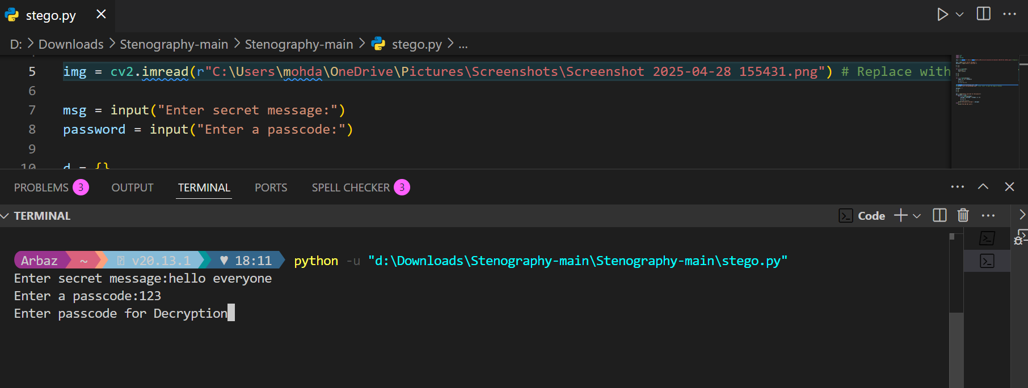
Results

Slide 8
Conclusion
This project demonstrates the use of basic cryptography and steganography techniques to secure messages within images. By encoding messages into the pixels of an image, the project highlights how digital media can be used for secret communication. While not highly secure by modern standards, the project provides an excellent introduction to the concepts of encryption, password protection, and steganography. The integration of OpenCV simplifies the manipulation of image data, making it easy to implement and understand. The project shows that cryptography doesn't have to be complex to be effective. It also encourages further exploration into more advanced techniques for data security. Overall, the project is a fun and educational way to learn about digital security.

Slide 9
GitHub Link
https://github.com/MDARBAZ18/Aicte_Cybersecurity.git

Slide 10
THANK YOU

